Slide 1

Scoping an Actionable ML Project
Rayid Ghani and Kit Rodolfa

Slide 2
Reminders
Due This Week
Make sure you’ve joined the class slack (and noted in canvas that you did)
Project teams and github usernames
Next Week
Monday: Initial look at the class project (colab assignment)
Tuesday: Submit weekly review (assignment) before class
All the readings for Tuesday are optional

Slide 3
Scope
Data
Exploration
Modeling
Get Data
Store Data
Link Data
Rows
Features
Labels
Model Selection
Train-Test Splits
Performance Metrics
Model Interpretation
Entities
temporal
Spatial
…
Models
Dealing with Bias and Fairness
Field Trial Design
Deployment
Monitoring
Goals, Actions, Data, Analysis, Ethics

Slide 4
Why Scoping is Critical
(Unfortunately) projects do not come as well-defined problems
A well-scoped project increases the likelihood of your work being used and having an impact
Shifts focus from “I have some data, what can I do with it” to starting with the problem, informing actions, and improving outcomes

Slide 5
Discussion Question
Which of the following are reasonable
goals for an applied ML project?
slido.com #8855186

Slide 6
The goal of this project is to build a model…
Doing some type of analysis may be the bulk of what you do during a project but the analysis is rarely the ultimate goal of the project.
A well-formulated/scoped project will have the analysis inform a follow-up action and help achieve intended policy/business/research goals (beyond conducting the analysis)

Slide 7
Before Scoping: Initial Screening Criteria
Real and significant problem (with clear impact)
Priority for the organization
Commitments in place:
Access to the data and to people who understand the data
Access to the people who understand the problem
Commitment to validate and take actions informed by your work

Slide 8
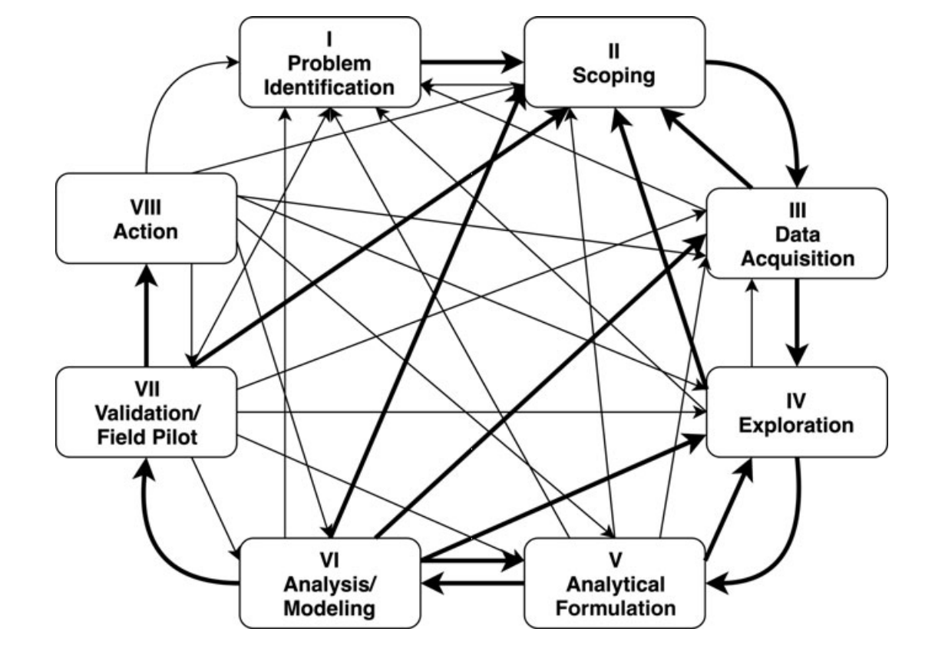
Scoping is an iterative and ongoing process
Involves different types of people
Gets refined over time
Gets modified as a result of later project phases

Slide 9
Things to remember
Make sure and check that you can access your project repo today and download the data
Thursday:
Readings (Obermeyer et al; Passi & Barocas)
What’s coming next week:
Assignment due Monday
Project Formulation and Baselines
Readings

Slide 10
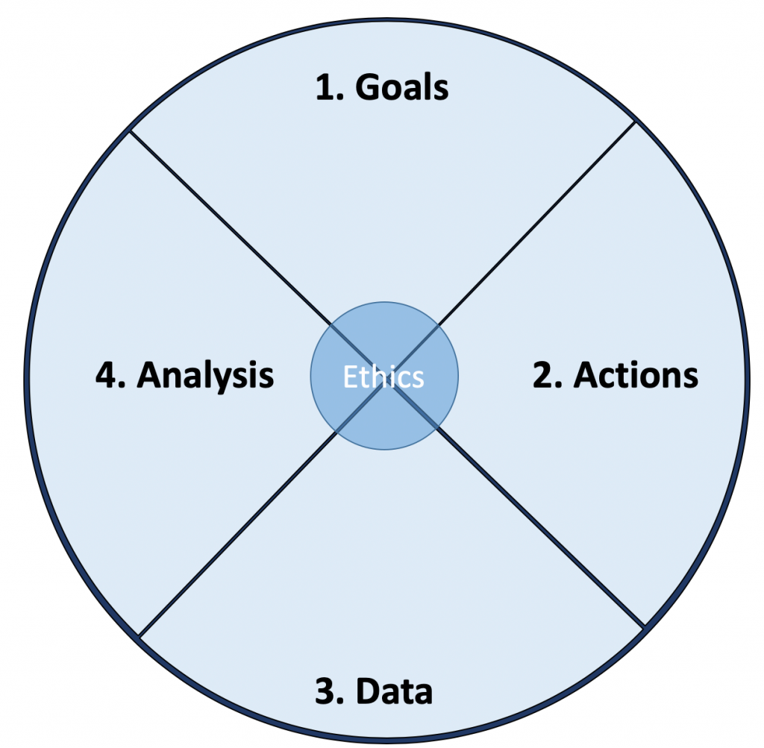
Actionable and Goal-Driven Project Scope
Goals: Define the goal(s) of the project
Actions: What actions/interventions will you inform?
Data: What data do you have internally? What data do you need? What can you augment from external and public sources?
Analysis: What analysis needs to be done? How will it be validated?
Ethics: What are the privacy, transparency, discrimination/equity, and accountability issues?
Problem
10
dsapp.uchicago.edu
@datascifellows
Center for Data Science and Public Policy University of Chicago

Slide 11
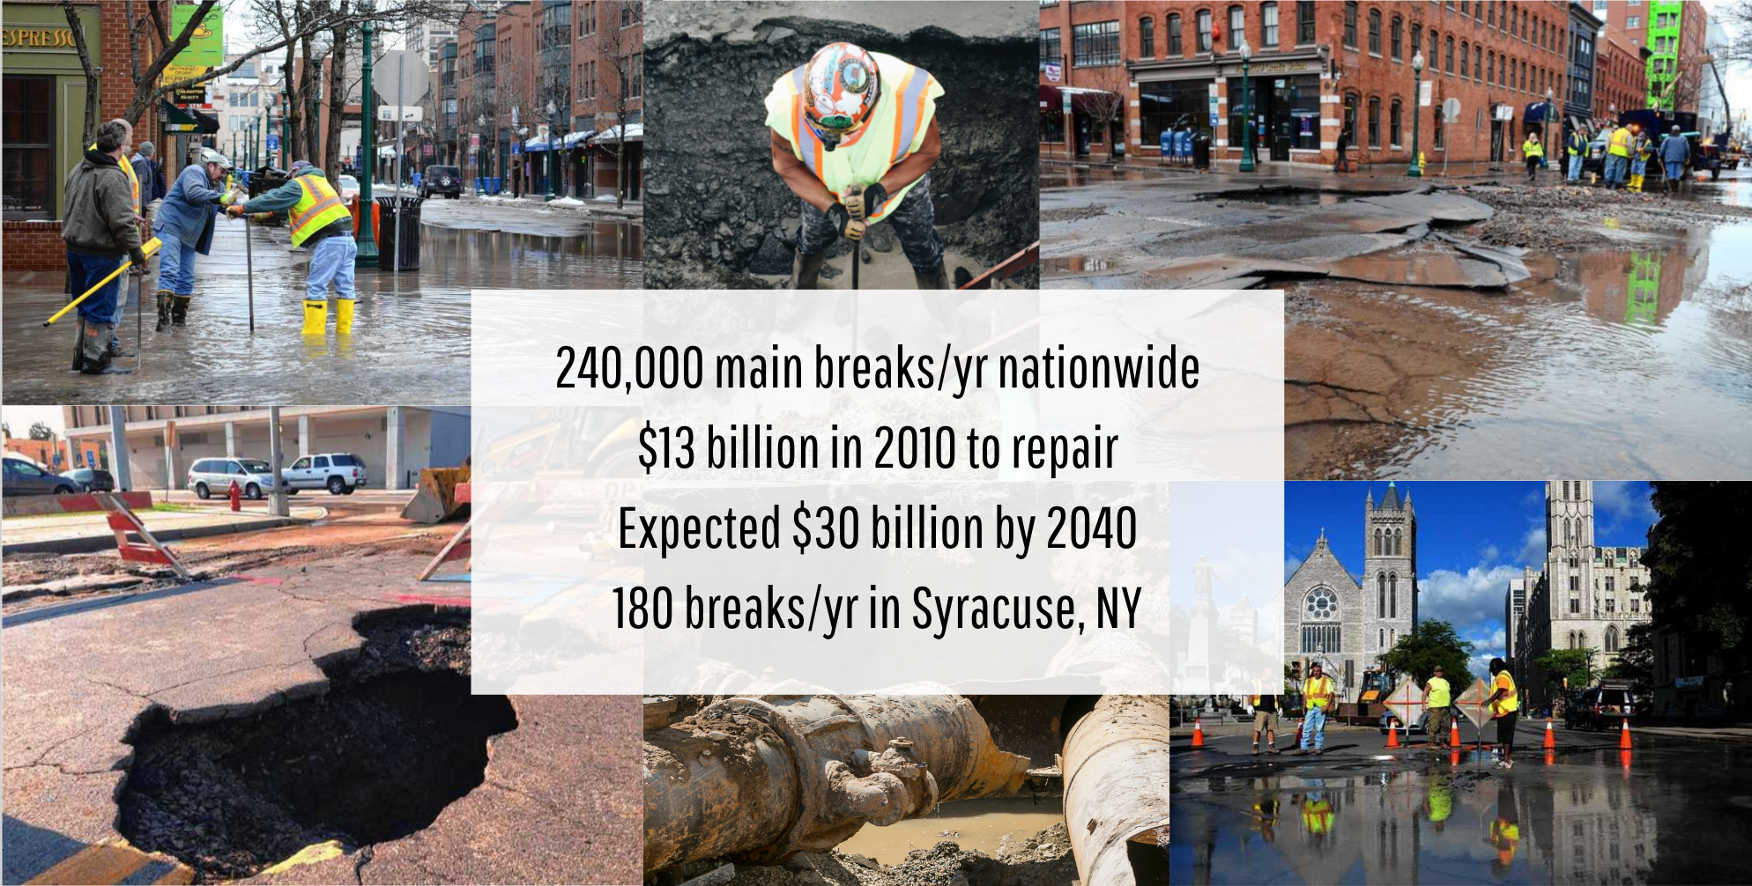
Case Study
240,000 main breaks/yr in US
$13 billion in 2010 to repair
Expected $30 billion by 2040
180 breaks/yr in Syracuse, NY

Slide 12
Step 1: Determine Goals
If you are successful doing this project, how would the world change?
Will the process you’re trying to improve become more efficient?
Will it be more effective?
Will it be more equitable/fair?
A combination of the above?

Slide 13
Step 1: Determine Goals
Goals need to be measurable and concrete
Goal is NOT to build a model or a map or dashboard, make a prediction, etc.
What are the relative priorities and tradeoffs for each goal?
What constraints do you face in achieving these goals?
Need to get different “stakeholders” involved up front

Slide 14
Problem Templates
Can I detect who’s going to get lead poisoning early?
Can I determine which home inspections to prioritize?
How do I improve the scheduling and assignment of my medics/ambulances/firetrucks?
Can I route citizen requests more efficiently and effectively?
Which policies do I modify to improve maternal mortality ?
How much impact is my after-school program having?
Can I get data that helps me match employers with employees ?
X
X
X
X
X
X
X

Slide 15
Types of Problems
Early Warning Systems
Compliance/Inspections/Audits
Routing (Physical or Virtual)
Scheduling
Policy Evaluation
Policy Hypothesis Generation

Slide 16
Step 2: Identify Actions to achieve the goal
What interventions/actions do I have access to?
What would someone do differently if they had more information or knew where their actions were most likely to be effective?
Informing these actions:
Who? (to target for each action)
What? (to say to them)
How? (to use different communication channels)

Slide 17
Step 2: Identify Actions to achieve the goal
Focus on concrete actions
Existing vs new actions
Consider the granularity of the actions
e.g. students who need help generally vs specific program
How frequently are interventions taken/planned?
How far out does planning occur?
Notes:
Stakeholders need to be bought in from the beginning or it won’t be effective

Slide 18
Step 3: Data Sources
What relevant data sources do you have?
What data do you need?
Important to match the granularity, frequency, and time horizon of the actions to the data
What external data can you augment this with?
dsapp.uchicago.edu

Slide 19
Step 3: Data Sources
Types of Data
Nobody knows what data the entire organization has
Don’t get intimidated by legal acronyms thrown at you
Data is never perfect – is it useful enough to improve over status quo?
Program Level
Transactional
Spatial
Text
Images/Audio/Video

Slide 20
Step 3: Data Sources
How reliable is the data?
How current is it?
How much of it is computer-readable?
How much of it is stored as notes, audio, photos, videos?
What resources and authority do you have to collect more?

Slide 21
Step 4: Analysis
What analysis needs to be done?
What type of methods should be used?
How will the analysis be validated?

Slide 22
Discussion Question
What are some of the categories of analysis we can use ML for?
slido.com #8855186

Slide 23
Types of Analysis Capabilities
Description (Understand the past)
Detection (Anomalies, Events, Patterns)
Prediction (Predict the Future)
Optimization
Behavior Change (Causal Inference)

Slide 24
Validation and Implementation Plan
Go back to the metrics and goals defined at the beginning of the project
Run a Pilot/Field Trial
Deploy
Set up Infrastructure and allocate resources to monitor “lift”

Slide 25
Discussion Question
What are some of ethical issues/considerations for this project?
slido.com #8855186

Slide 26
Data and AI Ethics Issues
Privacy
Data Ownership
Bias, Equity, & Fairness
Transparency
Trustworthiness and Accountability

Slide 27
Data Ethics Questions
Privacy & Confidentiality
Are you working with personal and/or sensitive data that is individually identifiable?
How are you protecting the data?
Data Ownership
Do the people who “own” the data know you’re using it?
Do you have their permission? How was it obtained?
How will/Can they opt out of their data being used?

Slide 28
Data Ethics Questions
Transparency
Do the people who “own” the data know you’re using it?
What actions are you taking on individuals based on this data?
Do the people you’re “targeting” know why and if they’re being “targeted”?
What recourse do they have?
Would it make the front page of the national newspaper if they found out what you’re doing?
Which stakeholders should know about which parts of the project?

Slide 29
Data Ethics Questions
Discrimination/Equity
Are there any specific groups for whom you want to ensure equity of outcomes?
How do you define, detect, and increase equity in outcomes?
Social License
If the entire population of the country finds out about your project, will they be ok with it? Why?
Accountability
Who are the people responsible and accountable for all the things above?
Any other considerations such as consent, legal, etc

Slide 30
A Few Things to Remember
Don’t be afraid to ask naïve questions
Spend time discussing goals and metrics – don’t forget equity as a goal
Understand what the current process/solution is
Communication is critical – before, during, and after
We need to make sure that we tackle these problems responsibly and ethically
Data and ML does not solve problems, people do. Is what you’re doing helping solve the problem?

Slide 31
Project Scoping Worksheet
http://bit.ly/dataprojectscoping

Slide 32
Reminders
Due This Week
Make sure you’ve joined the class slack (and noted in canvas that you did)
Project teams and github usernames
Next Week
Monday: Initial look at the class project (colab assignment)
Tuesday: Submit weekly review (assignment) before class
All the readings for Tuesday are optional

